Slide 1
SSW-810: Software Engineering Tools and Techniques
Advanced Python Topics
Prof. Jim Rowland
Software Engineering
School of Systems and Enterprises

Slide 2

Today’s topics
Decorators
Encapsulation
@property, @attribute.setter
Static methods
Polymorphism
Dynamic typing with Duck Typing

Slide 3
Decorators
Decorators allow us to extend the behavior of a function without modifying the function
Wrapping extra functionality before and after a function
Examples:
Time a function call
Track how many times a function is called
Memoize a function to use previous results
Mock a function call while testing
Web frameworks, e.g. Flask
https://wiki.python.org/moin/PythonDecoratorLibrary

Slide 4
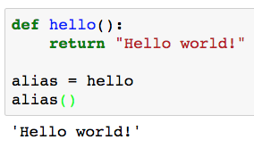
Python functions are first-class objects
Functions can be assigned to variables and passed as arguments to other functions
alias is now an alias for hello

Slide 5
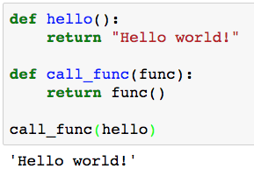
Python functions are first-class objects
Functions can be assigned to variables and passed as arguments to other functions
Pass function hello to call_func as an argument

Slide 6
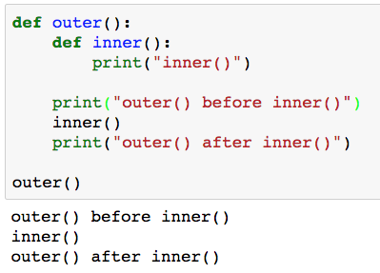
Nested functions
Functions can be nested inside other functions
inner() is visible only within outer()

Slide 7
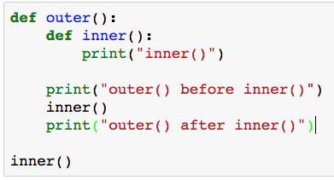
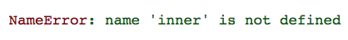
Nested functions
Nested functions are visible only inside the nesting function
inner() is visible only within outer()

Slide 8
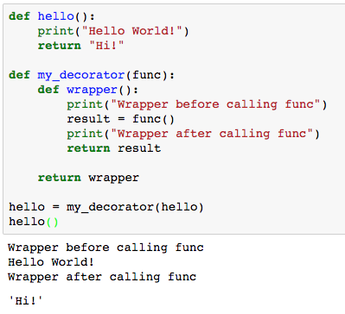
Decorators: Wrapping functions
arbitrary function
Return the inner wrapper function
hello is now the decorated hello so calling hello() calls my_decorator() and that calls the original hello()
Return value from hello()

Slide 9
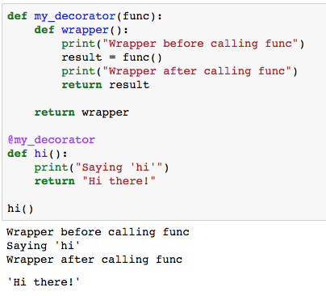
@decorator syntax
Syntactic shortcut for
hi = my_decorator(hi)
Now we can call the decorated hi() which calls the original hi() function

Slide 10
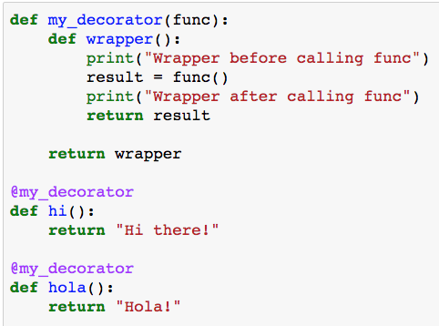
One decorator, many functions
We can apply the same decorator to many functions
Decorate many functions with the same decorator

Slide 11
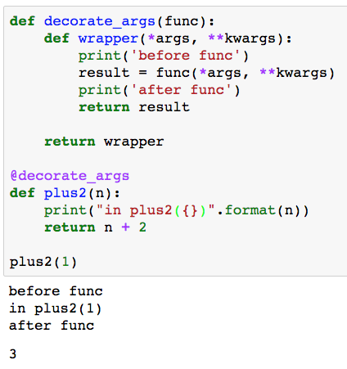
Decorating functions with arguments
wrapper() accepts any number of args and keyword args
Call func with args and kwargs
Return the result of calling func from wrapper

Slide 12
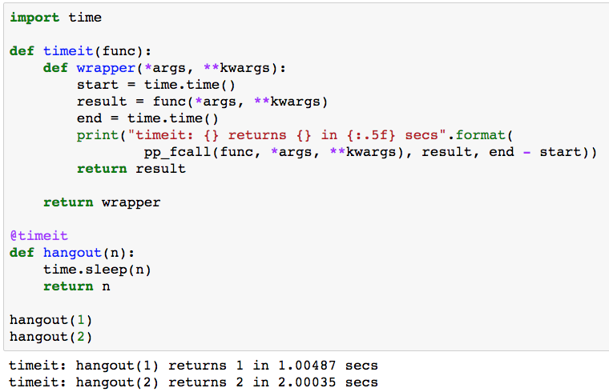
Execution time decorator
Accept any number/type of arguments
Print function elapsed time

Slide 13
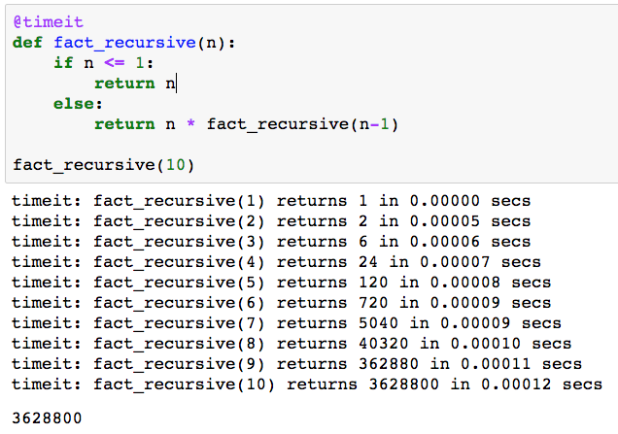
decorators: execution time
Reuse the timeit decorator for many functions

Slide 14
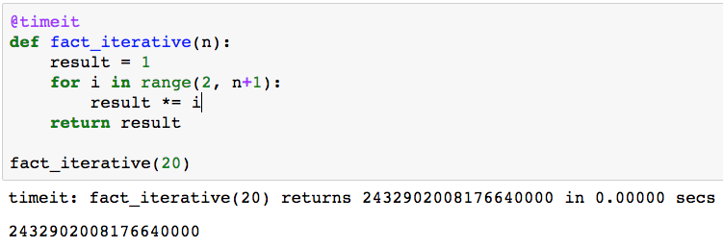
decorators: execution time
Print function elapsed time

Slide 15
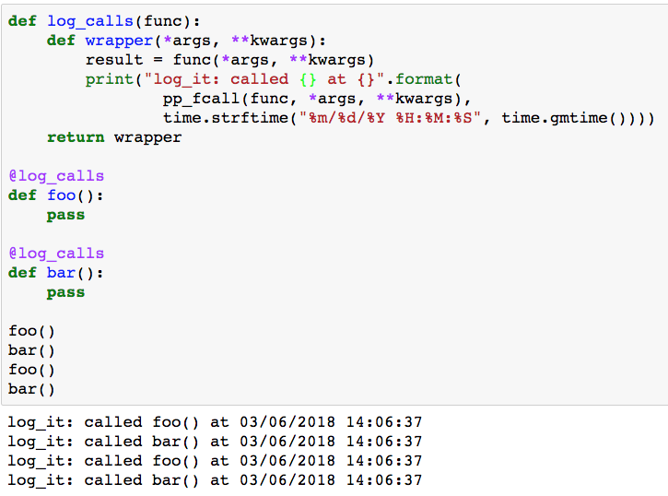
decorators: logging function calls

Slide 16
Decorators summary
Decorators allow us to extend the behavior of a function without modifying the function
Wrapping extra functionality before and after a function
@foo
def bar(): …
https://wiki.python.org/moin/PythonDecoratorLibrary
I won’t ask you to write a decorator but I do want you to understand what’s happending when you see one

Slide 17


Slide 18


Encapsulation/Information Hiding: Public vs Private interfaces in classes
 | Public Interfaces | Private Interfaces
Sharing | Shared freely with other modules | Not shared: details are hidden
Used by others | Safely used by other modules without concern of changes | Not available to other classes
Cost of change | New interfaces are cheap but changes may be very expensive if the change breaks other modules | Class implementation may change without impacting other modules

Slide 19
What are we protecting from whom and why?
What?
Attributes and methods critical to the proper behavior of the class
Design decisions, e.g. critical data structures
From whom?
Programmers (including the class author) with access to code
Data privacy is not relevant because the code is available
Subclasses derived from the superclass
Why?
Improve encapsulation to allow the internal implementation to change without impacting the public interfaces used by other code

Slide 20
Private/Protected attributes/methods
Java and C++ enforce public, protected, and private in the compiler
Python assumes that we’re all responsible adults and everyone will follow the Python conventions:
name (no _) tells the reader that name is public
_name (single _) tells the reader that _name is protected
__name (double _ ) tells the reader that __name is private and shouldn’t be used

Slide 21
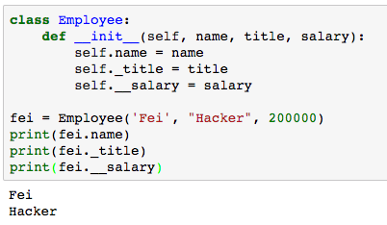
Private/Protected in Python
_name tells reader that _name is protected only by convention
__name tells reader that __name is private only by convention
self.name is public by convention
self._title is protected by convention
self.__salary is private by convention
Public and Protected names can be used as expected
Private names are hidden by name mangling

Slide 22
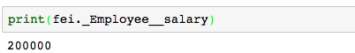
Private/Protected in Python
Don’t rely on private to protect sensitive information
_name is protected by convention
__name is private by convention
Protected names can be used as expected
Private names are hidden
Anyone with access to the code can still see all the details

Slide 23
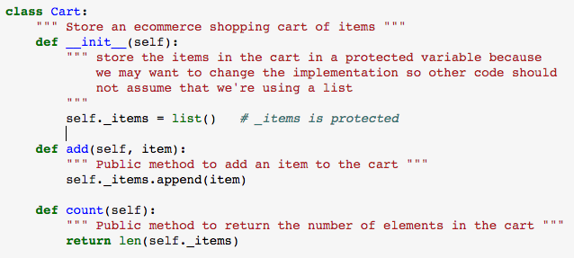
Private/Protected in Python
Use protected to warn readers not to rely on certain implementation details but most attributes are public
The implementation may change so don’t rely on protected attributes
It’s safe for other code to use public attributes and methods

Slide 24
e-Commerce Shopping Cart Item
Class Item:
Attributes
name
price
quantity
Methods
cost()
__str__()
Public so other code is free to assume that these interfaces will always be supported. The interfaces won’t change.
Public so other code is free to assume that these interfaces will always supported. The interfaces won’t change.

Slide 25
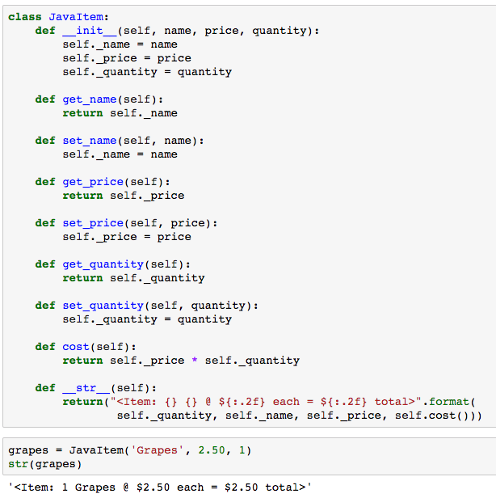
Java-inspired Item class methods
Getter()/Setter methods defined for all attributes
Pythonistas cringe at all the extra code

Slide 26
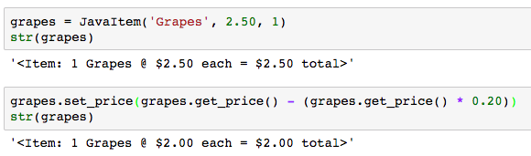
Adjust price to include 20% discount
Getters/Setters provide encapsulation at the cost of concise, readable code

Slide 27
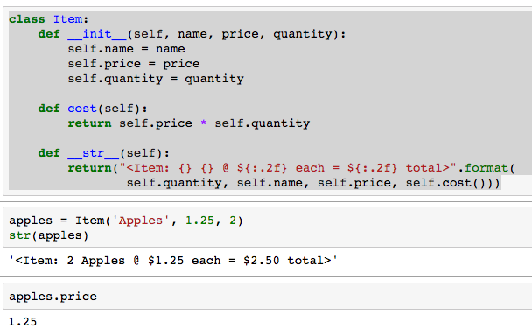
Pythonic Item class
name, price, and quantity are public
cost() and __str__() are public
All attributes are available with object.attribute notation

Slide 28
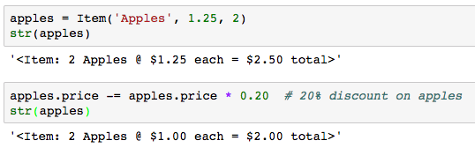
Discounting the price of Items
Getters/Setters provide encapsulation at the cost of concise code
Which is easier to read and maintain?
Which is easier to read and maintain?

Slide 29
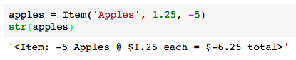
Encapsulation is a good thing…
Our class Item code is very popular and is widely reused in many projects
Developers have code using object.attribute notation
…BUT THEN…
Unscrupulous customers discover that negative quantities lead to refunds
This happened to Amazon.com
Oops! We owe money to the customer for buying apples!?!

Slide 30
Encapsulation is a good thing…
We need to guard the quantity attribute against negative values
… maybe getters/setters aren’t such a bad idea
… but, getters/setters bloat the code
… worse yet, other projects have existing code using object.attribute notation
We can’t expect everyone to change all references throughout their code
What’s a Pythonista to do???
Hint: we’re not converting to Java
Hint: maybe decorators can help!

Slide 31
@property, @setter
Python discourages getter/setter functions for attributes
Instead, Python encourages obj.attribute notation both for getting and setting attributes
What if you need extra logic around a getter or setter?
e.g. check for a valid range before returning or setting value
@property/@setter allows you to define a property of a class which is a function wrapper for an attribute’s getter and setter with extra functionality
Execute extra code while allowing users to use obj.attribute notation for getting/setting values

Slide 32
Changing quantity to an @property
Let’s change the semantics of Item.quantity to a function that checks for quantity < 0

Slide 33
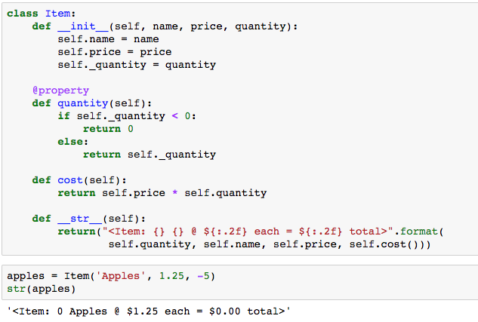
Getting Item.quantity with @property
Make _quantity protected
@property adds a read-only getter that is invoked when Item.quantity is accessed
We can still reference self.quantity and Python calls self.quantity()
We can still reference self.quantity and Python calls self.quantity()
Quantity < 0 is 0
Quantity < 0 is 0

Slide 34
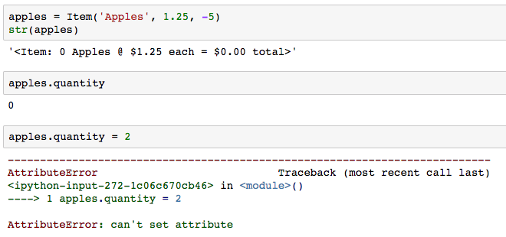
What if we need a setter()?
@property decorator defines a new read-only attribute that can be accessed with dot notation
What if we need to set the value?
Oops!!!

Slide 35
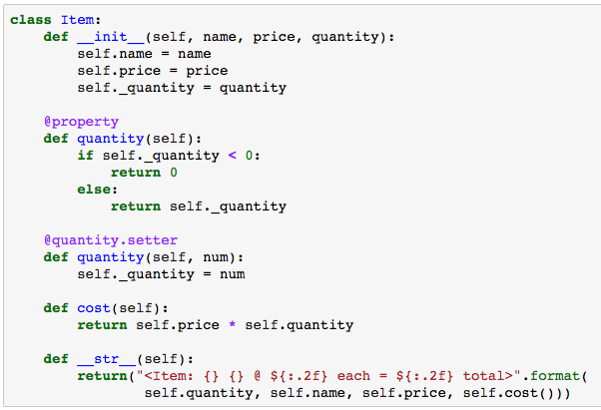
Adding a setter()
@name.setter decorator adds a method to set the value of name that can be accessed with dot notation

Slide 36
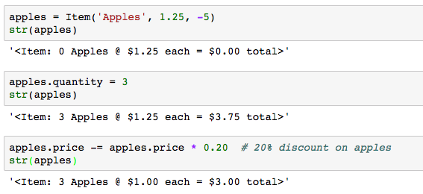
Using the setter()
@quantity.setter causes Item.quantity(self, num) to be called on assignment
The legacy 20% discount code using dot notation still works without change

Slide 37
@property/@attribute.setter review
We defined class Item with public attributes
Our code and code from others used dot notation to access the public attributes
We needed to change the class without breaking backward compatibility of dot notation
@property allows us to define a method to an attribute that is invokes when the value is retrieved
@attribute.setter allows to add an optional setter method

Slide 38
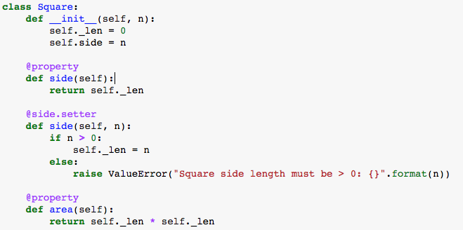
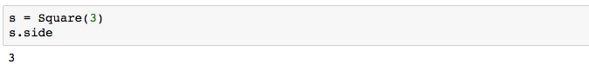
@property/@attribute.setter example
_len holds the protected length of the side
Users refer to ‘side’
Call the setter to check the value
Prevent setting _len < 0, even in __init__()

Slide 39
@property/@attribute.setter example
Invoke the setter to validate the parameter
__init__() uses the setter to validate the parameter

Slide 40
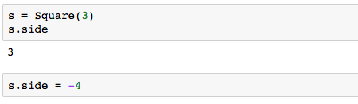
@property/@attribute.setter example
Use the @property to read the value
The @setter validates the value

Slide 41
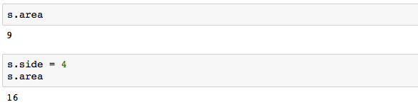
@property/@attribute.setter example
@property can be used for more than just validation
area is available as Square.area
Changing side changes area

Slide 42
@property/@attribute.setter example
area is read-only

Slide 43
@property/@attribute.setter Summary
@property decorator adds a read-only attribute to a class that calls the associated method when the attribute is accessed with dot notation
@attribute.setter decorator adds a setter method to attribute where the method is invoked when the attribute is accessed with dot notation
@property and @attribute.setter can be used together or @property can be used alone for read-only
Can be added after code deployment to change behavior of an attribute without changing legacy code, e.g. add checks

Slide 45
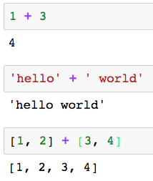
Polymorphism
Polymorphism allows an operator to behave differently depending upon the types of the operands
How does this work?
How does Python know which version of ’+’ to apply?
integer arithmetic
string concatenation
list concatenation

Slide 46
Dynamic and Static Typing
Statically typed
C++, Java
Variables are declared with a static type
The compiler uses the static type information to support polymorphism
Dynamically typed
Python
An object’s type is determined at run time
Python chooses the appropriate class method based on the type of the object

Slide 47
Duck Typing
Duck typing is a dynamic typing method
Python uses duck typing to support polymorphism
If it walks like a duck and quacks like a duck, it’s probably a duck
Python: if an object has a relevant property, then apply it
Duck typing supports polymorphism with or without inheritance

Slide 48
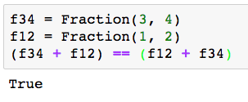
Duck typing example
Recall the Fraction homework from earlier in the semester
We used Python’s magic methods to support inline operators
Python determines the type of f34 and f12 at run time to choose the appropriate version of __add__() to invoke
We can use Duck Typing with or without inheritance to simplify out design and implementation

Slide 50
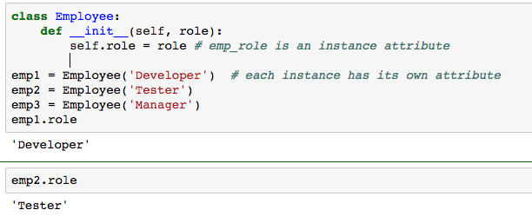
Instance Attributes vs Class Attributes
Instance attributes are replicated in every instance of a class
Defined in __init__() or added after the class is defined
A distinct instance of role is included in every instance of class Employee

Slide 51
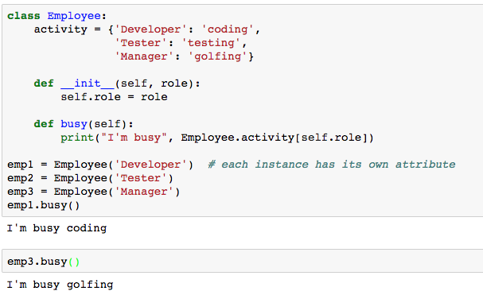
Instance Attributes vs Class Attributes
A Class attribute exists exactly once across all instances of a class
Defined outside __init__() or after the class is defined
A single instance of Employee. activity is shared across every instance of class Employee

Slide 52
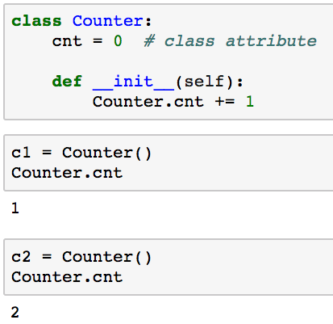
Referencing class attributes
How should we reference class attributes?
Reference instance attributes as instance.attribute
Reference class attributes as class.attribute
Reference the class attribute as
Class.attribute

Slide 53
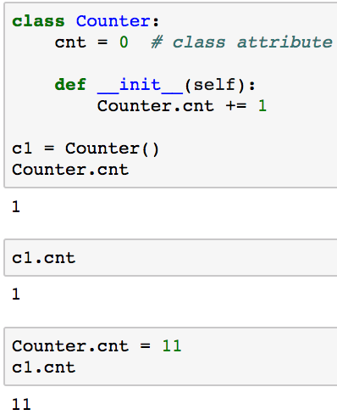
What could possibly go wrong?
We can also reference class attributes as instance.class_attribute BUT that can lead to unexpected behavior
Oops! c1.cnt changed because it is a reference to Counter.cnt
Treating c1.cnt like an instance attribute, but it’s a class attribute
Oops!

Slide 54
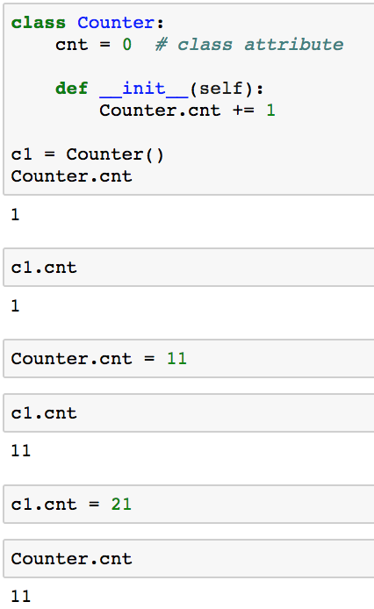
What could be even more confusing?
Assigning a value to instance.class_attribute creates a new instance attribute that takes precedence over the class attribute
c1.cnt references class attribute in c1
Now, c1.cnt references a new
instance attribute in c1,not the class attribute
c1.cnt = 11 creates a new instance attribute named cnt only in c1

Slide 55
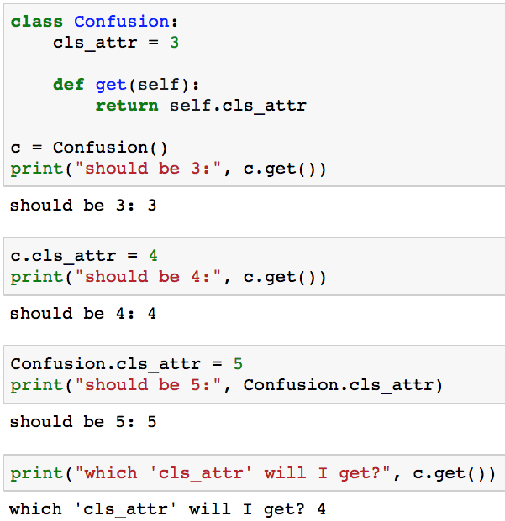
Class Attributes and self
Self is just an instance – avoid self.class_attribute
Python checks first for an instance attribute and then for a class attribute
No instance attribute named ‘cls_attr’ so use class attribute Confusion.cls_attr
Create a new instance attribute named ‘cls_attr’ in self
Change the value of class attribute Confusion.cls_attr
Use self’s instance attribute ‘cls_attr’

Slide 56
Static Methods
Static methods look just like other methods but are not associated with a specified class instance
No self parameter because the method is not associated with a a specific instance
Instance attributes are not available – no class instance
Class attributes are available
Static methods can be replaced with procedural function calls
Static methods offer extra encapsulation and consistency
Static methods are fairly unusual

Slide 57
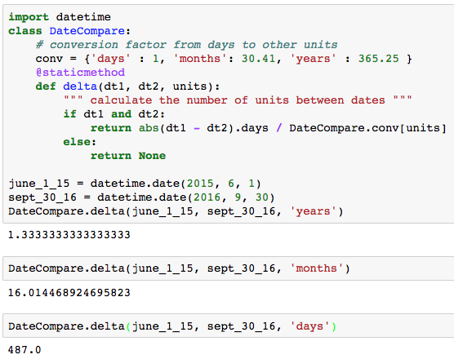
Static Methods
conv is a class instance. Only one instance across all instances of class DateCompare
No self because this is a static method
@staticmethod is decorator

Slide 59
Stevens Data Repository
HW09: Build Stevens Data Repository
Students
Instructors
Print Student Summary
Print Instructor Summary
HW10: Enhance Stevens Data Repository
Add majors
Enhance Student Summary with remaining classes
HW11: Store data in SQL database
HW12: Present the data with a Flask web interface

Slide 60

Questions?

Slide 61
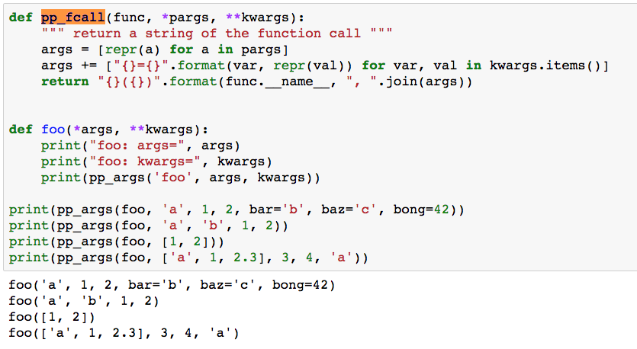
pp_fcall

